Slide 1

Decoding the neural representation
of social concepts
Daniel Alcalá López, David Soto
May 16, 2018

Slide 2

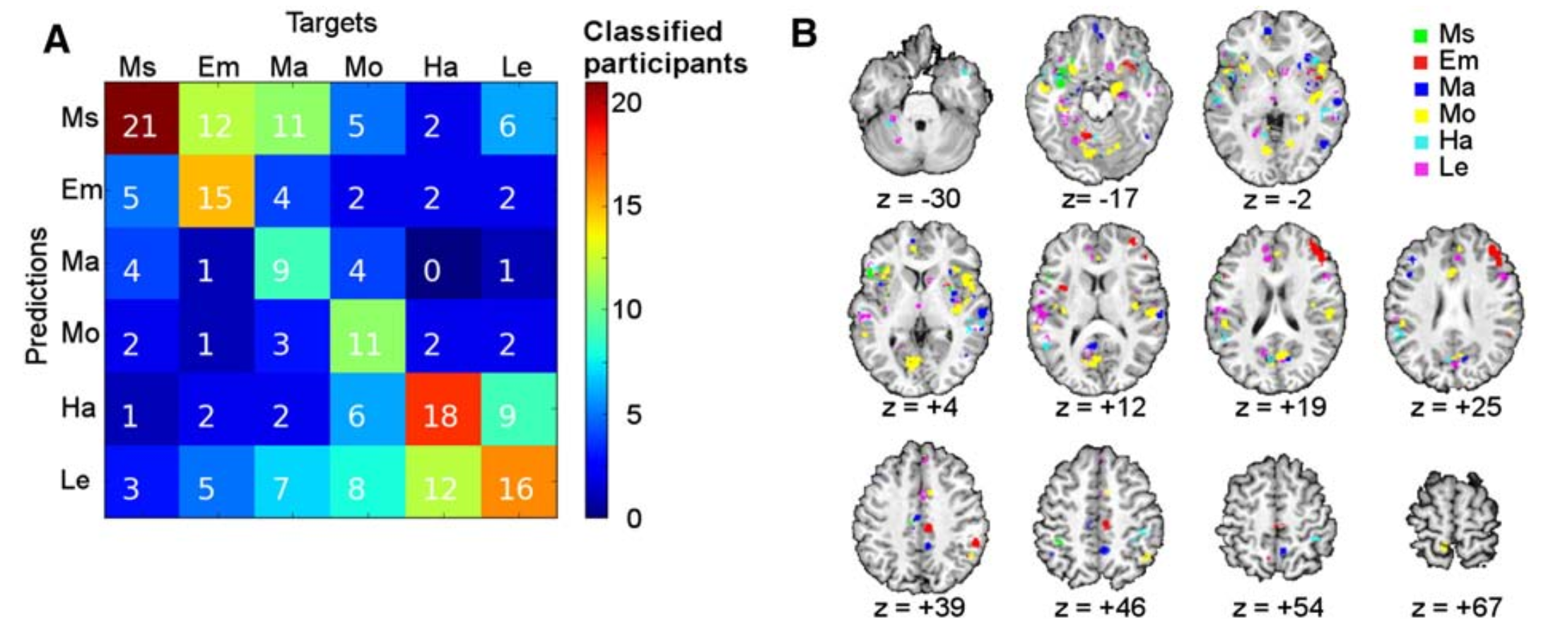
Previous work assessed the neural representations of concrete concepts
(e.g. animals or tools)
Few studies using abstract concepts (e.g. mathematical or mental)
Ghio et al. 2016 Neuroimage

Slide 3
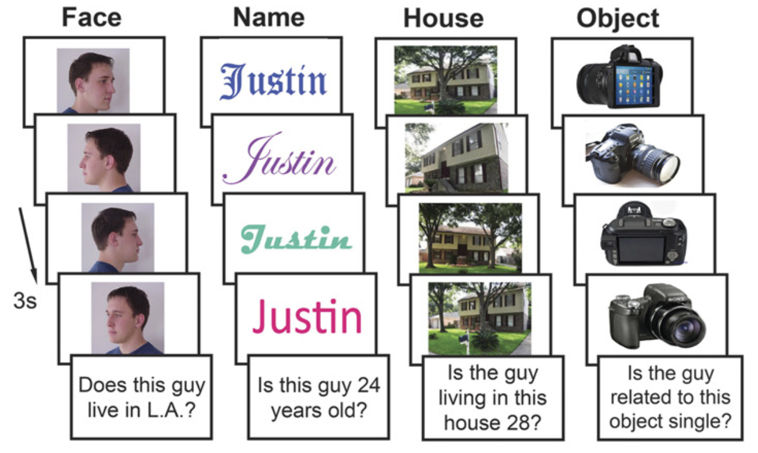
Faces, voices, body gestures,
biological movements…
Social information
concepts?
Wang et al. 2017 PNAS

Slide 4
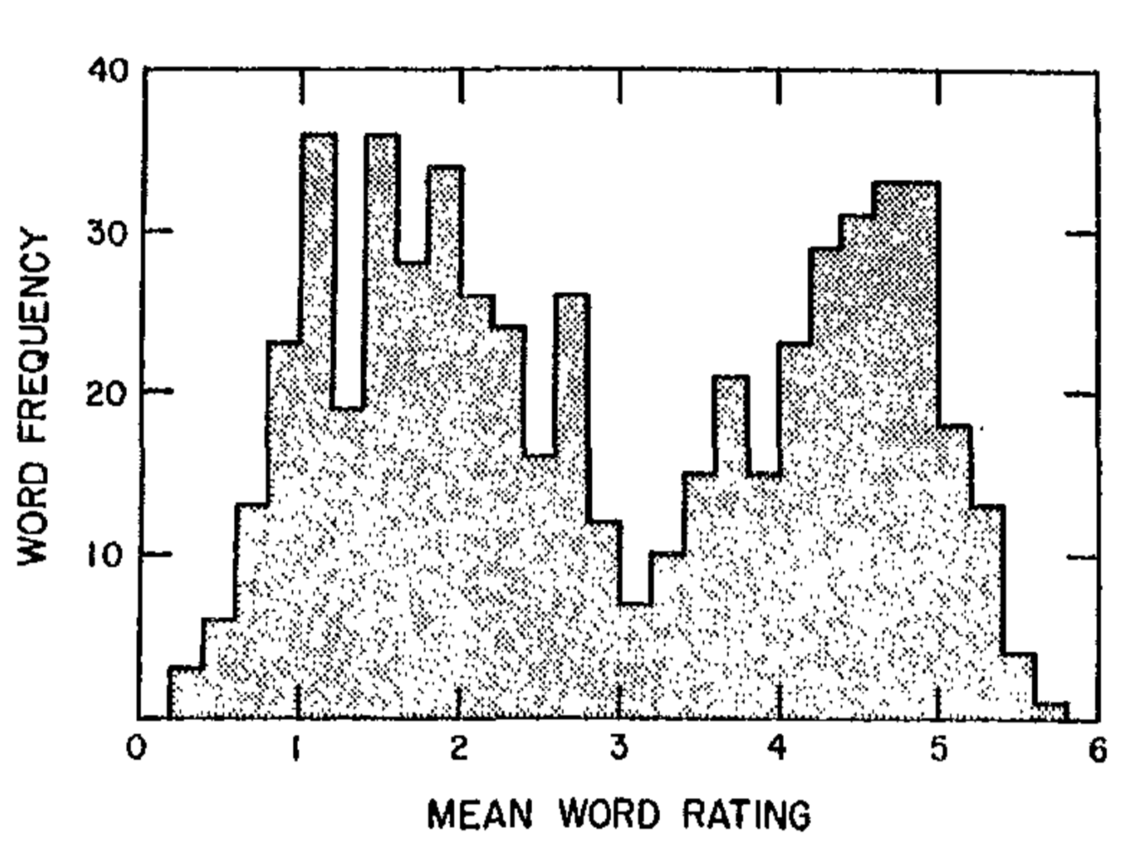
Aim: to study how social abstract concepts are represented in the brain
+ particularly, with regard to the two fundamental social-cognitive processes:
mentalize about the beliefs, intentions, or attitudes of others
empathize with the emotions of others
+ likableness
Anderson 1968 J Pers Soc Psychol

Slide 5
Participants:
listen to short definitions of social concepts
think about the concept (e.g. attribute the referred
interpersonal attitudes, beliefs, intentions, or emotions
to a family member, acquaintance, public figure, etc.)
fixation
*
delay
“Sabe razonar, resolver problemas
y comprender ideas complejas”
definition
250 ms
500 ms
think
jitter
3 s
*
3 s
catch trial
8 s
INTELIGENTE

Slide 6
mentalizing concepts
empathizing concepts
Sincero/a
Comprensivo/a
Leal
Inteligente
Generoso/a
Ingenioso/a
Cooperativo/a
Indulgente
Concienzudo/a
Sincere
Understanding
Loyal
Intelligent
Unselfish
Clever
Helpful
Forgiving
Conscientious
high likableness
Empático/a
Afable
Bondadoso/a
Animado/a
Cariñoso/a
Entusiasta
Agradecido/a
Sensible
Compasivo/a
Empathetic
Good-natured
Kind
Cheerful
Warm-hearted
Enthusiastic
Grateful
Sensible
Sympathetic
Vago/a
Irresponsable
Prejuicioso/a
Aburrido/a
Hostil
Egoísta
Maleducado/a
Codicioso/a
Farsante
Lazy
Irresponsible
Prejudiced
Boring
Hostile
Selfish
Rude
Greedy
Phony
Envidioso/a
Exaltado/a
Neurótico/a
Resentido/a
Pesimista
Despiadado
Condescendiente
Insensible
Cruel
Envious
Hot-tempered
Neurotic
Resentful
Gloomy
Unforgiving
Snobbish
Insensitive
Cruel
low likableness

Slide 7
removal of non-brain tissue using FSL’s BET
volume realignment using MCFLIRT
gaussian kernel (FWHM = 3mm) for spatial smoothing
ICA-based automatic removal of motion artefacts
temporal filtering (high-pass; cutoff = 60s)
coalignment of each session to a reference volume (1st session)

Slide 8
7 ROIs based on previous studies
+ semantic (abstract vs. concrete concepts): IPL, ATL, IFG
+ theory of mind tasks: mPFC, PCC
+ empathy tasks: AI, dACC
We will conduct hypothesis-driven MVP analyses in our a priori ROIs
Further exploratory analyses will be conducted using a searchlight approach to assess the decoding of social clases & social likebleness concepts across the whole brain

Slide 9
Multi-voxel pattern analysis
SVM-based linear classifier to decode:
+ the social nature of the definitions (theory of mind vs. empathy)
+ their likableness (high vs. low)

Slide 10
PCA-based feature selection within each ROI
leave-one-out cross-validation (500 permutations)
significance of decoding performance at the group level (one-sample t-test,
across subjects, corrected by the number of ROIs)

